Slide 1
UNIT II
Data Structures & Control Flow Statements

Slide 2
Python Data Structures
Data Structures are a way of organizing data so that it can be accessed more efficiently depending upon the situation.
Lists
Python Lists are just like the arrays, declared in other languages which is an ordered collection of data. It is very flexible as the items in a list do not need to be of the same type.
Example :
List = [1, 2, 3, "GFG", 2.3]
print(List)
Output
[1, 2, 3, 'GFG', 2.3]

Slide 3
Example
List = ["Geeks", "For", "Geeks"]
print("\nList containing multiple values: ")
print(List)
List2 = [['Geeks', 'For'], ['Geeks']]
print("\nMulti-Dimensional List: ")
print(List2)
print("Accessing element from the list")
print(List[0])
print(List[2])
# print the last element of list
print(List[-1])
# print the third last element of list
print(List[-3])

Slide 4
OUTPUT
List containing multiple values:
['Geeks', 'For', 'Geeks']
Multi-Dimensional List:
[['Geeks', 'For'], ['Geeks']]
Accessing element from the list
Geeks
Geeks
Geeks
Geeks

Slide 5
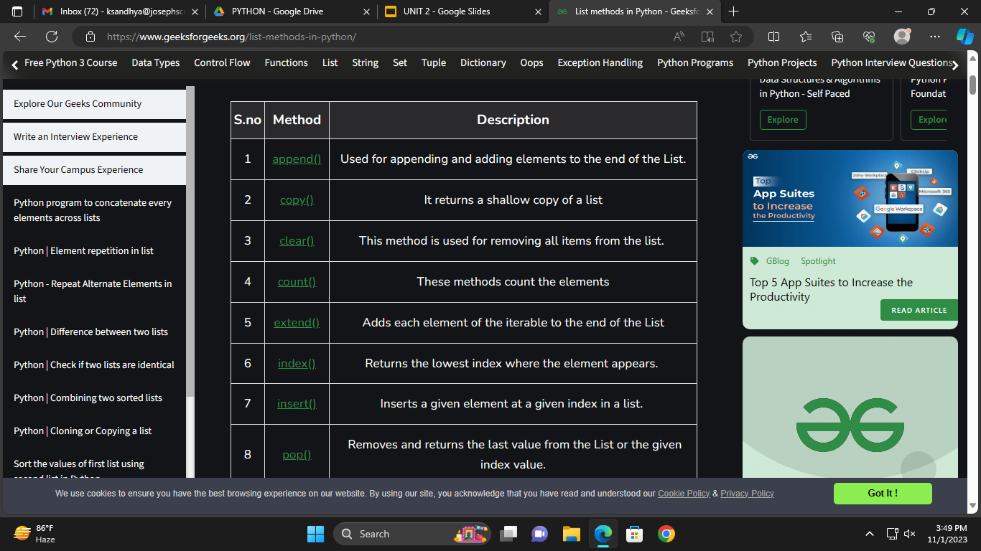
Lists Methods

Slide 6
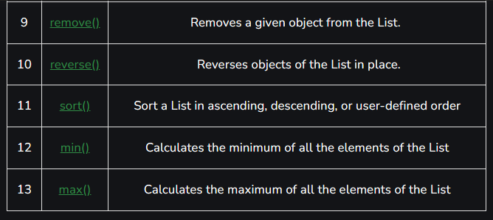
Lists Methods

Slide 7
append() : Used for appending and adding elements to the List. It is used to add elements to the last position of the List
Syntax: list.append (element)
insert() : Inserts an element at the specified position.
list.insert(<position, element)
extend() Adds contents to List2 to the end of List1.
Syntax: List1.extend(List2)
sum()
Calculates the sum of all the elements of the List.
Syntax: sum(List)
count()
Calculates the total occurrence of a given element of the List.
Syntax: List.count(element)
length
Calculates the total length of the List.
Syntax: len(list_name)

Slide 8
index()
Returns the index of the first occurrence. The start and end indexes are not necessary parameters.
Syntax: List.index(element[,start[,end]])
min()
Calculates minimum of all the elements of List.
Syntax: min(iterable, *iterables[, key])
max()
Calculates the maximum of all the elements of the List.
Syntax: max(iterable, *iterables[, key])
reverse()
Sort the given data structure (both tuple and list) in ascending order. Key and reverse_flag are not necessary parameter and reverse_flag is set to False if nothing is passed through sorted().
Syntax
sorted([list[,key[,Reverse_Flag]]])
list.sort([key,[Reverse_flag]])

Slide 9
PROGRAM
List = ['Mathematics', 'chemistry', 1997, 2000]
List.append(20544)
print(List)
List.insert(2, 10087)
print(List)
List1 = [1, 2, 3]
List2 = [2, 3, 4, 5]
List1.extend(List2)
print(List1)
List2.extend(List1)
print(List2)
List = [1, 2, 3, 4, 5]
print(sum(List))
List = [1, 2, 3, 1, 2, 1, 2, 3, 2, 1]
print(List.count(1))
print(len(List))
print(List.index(2))

Slide 10
OUTPUT
['Mathematics', 'chemistry', 1997, 2000, 20544]
['Mathematics', 'chemistry', 10087, 1997, 2000, 20544]
[1, 2, 3, 2, 3, 4, 5]
[2, 3, 4, 5, 1, 2, 3, 2, 3, 4, 5]
15
4
10
1

Slide 11
PROGRAM
numbers = [5, 2, 8, 1, 9]
print(min(numbers))
print(max(numbers))
List = [2.3, 4.445, 3, 5.33, 1.054, 2.5]
#Reverse flag is set True
List.sort(reverse=True)
#List.sort().reverse(), reverses the sorted list
print(List)

Slide 12
OUTPUT
['Mathematics', 'chemistry', 1997, 2000, 20544]
['Mathematics', 'chemistry', 10087, 1997, 2000, 20544]
[1, 2, 3, 2, 3, 4, 5]
[2, 3, 4, 5, 1, 2, 3, 2, 3, 4, 5]
15
4
10
1
1
9
[5.33, 4.445, 3, 2.5, 2.3, 1.054]

Slide 13
Dictionary : Dictionary holds the key:value pair.
Example:
Dict = {'Name': 'Geeks', 1: [1, 2, 3, 4]}
print("Creating Dictionary: ")
print(Dict)
# accessing a element using key
print("Accessing a element using key:")
print(Dict['Name'])
# accessing a element using get() # method
print("Accessing a element using get:")
print(Dict.get(1))
# creation using Dictionary comprehension
myDict = {x: x**2 for x in [1,2,3,4,5]}
print(myDict)

Slide 14
Output:
Creating Dictionary:
{'Name': 'Geeks', 1: [1, 2, 3, 4]}
Accessing a element using key:
Geeks
Accessing a element using get:
[1, 2, 3, 4]
{1: 1, 2: 4, 3: 9, 4: 16, 5: 25}
tuple.count(element)

Slide 15
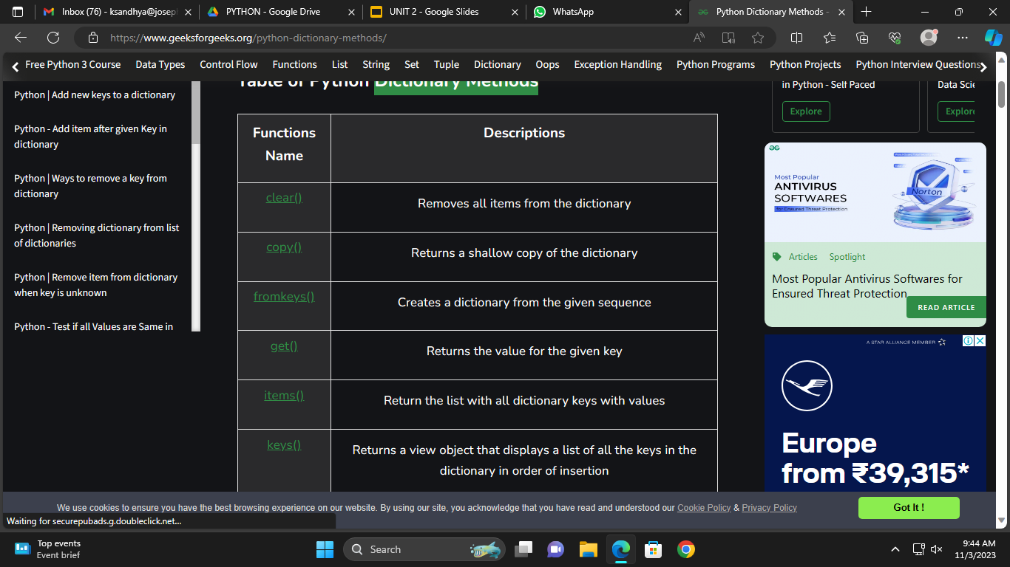
Dictionary Methods

Slide 16
clear() Method
The clear() method in Python is a built-in method that is used to remove all the elements (key-value pairs) from a dictionary. It essentially empties the dictionary, leaving it with no key-value pairs.
car = {
"brand": "Ford",
"model": "Mustang",
"year": 1964
}
car.clear()
print(car)
Output:
{}

Slide 17
get() Method
In Python, the get() method is a pre-built dictionary function that enables you to obtain the value linked to a particular key in a dictionary. It is a secure method to access dictionary values without causing a KeyError if the key isn’t present.

Slide 18
PROGRAM
d = {'Name': 'Ram', 'Age': '19', 'Country': 'India'}
print(d.get('Name'))
print(d.get('Gender'))
Output:
Ram
None
items() Method
In Python, the items() method is a built-in dictionary function that retrieves a view object containing a list of tuples. Each tuple represents a key-value pair from the dictionary. This method is a convenient way to access both the keys and values of a dictionary simultaneously, and it is highly efficient.

Slide 19
PROGRAM
d = {'Name': 'Ram', 'Age': '19', 'Country': 'India'}
print(d.get('Name'))
print(d.get('Gender'))
Output:
Ram
None
copy() Method
The copy() method returns a copy of the specified dictionary.
Syntax
dictionary.copy()

Slide 20
car = {
"brand": "Ford",
"model": "Mustang",
"year": 1964
}
x = car.copy()
print(x)
Output
{'brand': 'Ford', 'model': 'Mustang', 'year': 1964}

Slide 21
get() Method
The get() method returns the value of the item with the specified key.
Syntax
dictionary.get(keyname, value)
car = {
"brand": "Ford",
"model": "Mustang",
"year": 1964
}
x = car.get("model")
print(x)

Slide 22
Output
Mustang

Slide 23
Tuple: Tuples are used to store multiple items in a single variable.
Tuples are created by placing a sequence of values separated by ‘comma’ with or without the use of parentheses for grouping of the data sequence.
A tuple is a collection which is ordered and unchangeable.
Example:
thistuple = ("apple", "banana", "cherry")
print(thistuple)

Slide 24
Unchangeable
Tuples are unchangeable, meaning that we cannot change, add or remove items after the tuple has been created.
Allow Duplicates
Since tuples are indexed, they can have items with the same value
thistuple = ("apple", "banana", "cherry", "apple", "cherry")
print(thistuple)
Output:
('apple', 'banana', 'cherry', 'apple', 'cherry')

Slide 25
Tuple Methods :
Count() Method
The count() method of Tuple returns the number of times the given element appears in the tuple.
Syntax:
tuple.count(element)
Where the element is the element that is to be counted.

Slide 26
PROGRAM
Tuple1 = (0, 1, 2, 3, 2, 3, 1, 3, 2)
Tuple2 = ('python', 'geek', 'python', 'for', 'java', 'python')
# count the appearance of 3
res = Tuple1.count(3)
print('Count of 3 in Tuple1 is:', res)
# count the appearance of python
res = Tuple2.count('python')
print('Count of Python in Tuple2 is:', res)
Output:
Count of 3 in Tuple1 is: 3
Count of Python in Tuple2 is: 3

Slide 27
Index() Method
The Index() method returns the first occurrence of the given element from the tuple.
Syntax:
tuple.index(element, start, end)
Parameters:
element: The element to be searched.
start (Optional): The starting index from where the searching is started
end (Optional): The ending index till where the searching is done
Tuple = (0, 1, 2, 3, 2, 3, 1, 3, 2)
# getting the index of 3
res = Tuple.index(3)
print('First occurrence of 3 is', res)
# getting the index of 3 after 4th # index
res = Tuple.index(3, 4)
print('First occurrence of 3 after 4th index is:', res)

Slide 28
Output:
First occurrence of 3 is 3
First occurrence of 3 after 4th index is: 5

Slide 29
Example :
Tuple = ('Geeks', 'For')
print("\nTuple with the use of String: ")
print(Tuple)
# Creating a Tuple with the use of list
list1 = [1, 2, 4, 5, 6]
print("\nTuple using List: ")
Tuple = tuple(list1)
# Accessing element using indexing
print("First element of tuple")
print(Tuple[0])
# Accessing element from last negative indexing
print("\nLast element of tuple")
print(Tuple[-1])
print("\nThird last element of tuple")
print(Tuple[-3])

Slide 30
output:
Tuple with the use of String:
('Geeks', 'For')
Tuple using List:
First element of tuple
1
Last element of tuple
6
Third last element of tuple
4

Slide 31
Join Two Tuples
To join two or more tuples you can
tuple1 = ("a", "b" , "c")
tuple2 = (1, 2, 3)
tuple3 = tuple1 + tuple2
print(tuple3)
use the + operator:
Output:
('a', 'b', 'c', 1, 2, 3)

Slide 32
Python Sequences
In Python programming, sequences are a generic term for an ordered set which means that the order in which we input the items will be the same when we access them.
Python supports six different types of sequences. These are strings, lists, tuples, byte sequences, byte arrays, and range objects.
Python Strings
Strings are a group of characters written inside a single or double-quotes. Python does not have a character type so a single character inside quotes is also considered as a string.

Slide 33
Code:
name = “TechVidvan”
type(name)
Output:
<class ‘str’>
Bytes Sequences in Python
The bytes() function in Python is used to return an immutable bytes sequence. Since they are immutable, we cannot modify them.
If you want a mutable byte sequence, then it is better to use byte arrays. This is how we can create a byte of a given integer size.

Slide 34
Code:
size = 10
b = bytes(size)
print( b )
Output:
b’\x00\x00\x00\x00\x00\x00\x00\x00\x00\x00′

Slide 35
Byte Arrays in Python
Byte arrays are similar to bytes sequence. The only difference here is that byte arrays are mutable(that can be changed after they are created) while bytes sequences are immutable(that cannot be changed after they are created). So, it also returns the bytes object the same way.
Code:
print( bytearray(4) )
print( bytearray([1, 2, 3, 4]) )
print( bytearray(‘Hola!’, ‘utf-8’))
Output:
bytearray(b’\x00\x00\x00\x00′)
bytearray(b’\x01\x02\x03\x04′)
bytearray(b’Hola!’)

Slide 36
Python range() objects
range() is a built-in function in Python that returns us a range object. The range object is nothing but a sequence of integers. It generates the integers within the specified start and stop range.
Let’s see this with an example.
Code:
num = range(10)
print( type(num) )
Output:
<class ‘range’>

Slide 37
Code:
for i in range(5):
print(i)
Output:
0
1
2
3
4
The first argument is the starting range, the second argument is the stopping range and the third argument tells how many steps to take.

Slide 38
Code:
for i in range(4,16,2):
print()
Output:
4
6
8
10
12
14

Slide 39
Control Flow Statements
Control statements are designed to serve the purpose of modifying a loop's execution from its default behaviour. Based on a condition, control statements are applied to alter how the loop executes.
There are three types of conditional statements.
if statement
if-else
if-elif-else
If statement in Python
In control statements, The if statement is the simplest form. It takes a condition and evaluates to either True or False.
If the condition is True, then the True block of code will be executed, and if the condition is False, then the block of code is skipped, and The controller moves to the next line
Syntax of the if statement
if condition:
statement 1
statement 2
statement n

Slide 40
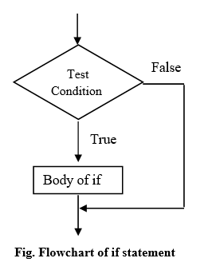
number = 6
if number > 5:
print(number * number)
print('Next lines of code')
Output
36
Next lines of code

Slide 41
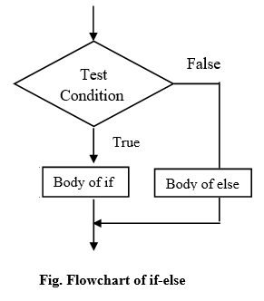
If – else statement
The if-else statement checks the condition and executes the if block of code when the condition is True, and if the condition is False, it will execute the else block of code.
Syntax of the if-else statement
if condition:
statement 1
else:
statement 2

Slide 42
password = input('Enter password ')
if password == "PYnative@#29":
print("Correct password")
else:
print("Incorrect Password")
Enter password PYnative@#29
Correct password
If-elif-else : SYNTAX
if condition-1:
statement 1
elif condition-2:
stetement 2
elif condition-3:
stetement 3 ...
else: statement

Slide 43
a = 200
b = 33
if b > a:
print("b is greater than a")
elif a == b:
print("a and b are equal")
else:
print("a is greater than b")
Output
a is greater than b

Slide 44
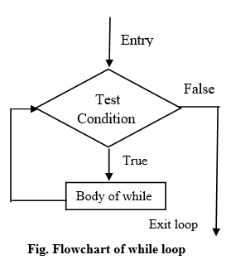
Looping Statements
The while loop statement repeatedly executes a code block while a particular condition is true. In a while-loop, every time the condition is checked at the beginning of the loop, and if it is true, then the loop’s body gets executed. When the condition became False, the controller comes out of the block.

Slide 45
Syntax of while-loop
while condition :
body of while loop
Program:
i = 1
while i < 6:
print(i)
i += 1
Output
1
2
3
4
5

Slide 46
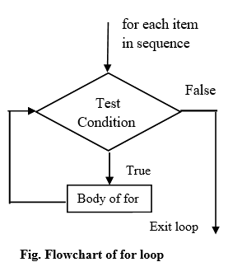
for loop
Syntax of for loop:
for element in sequence:
body of for loop

Slide 47
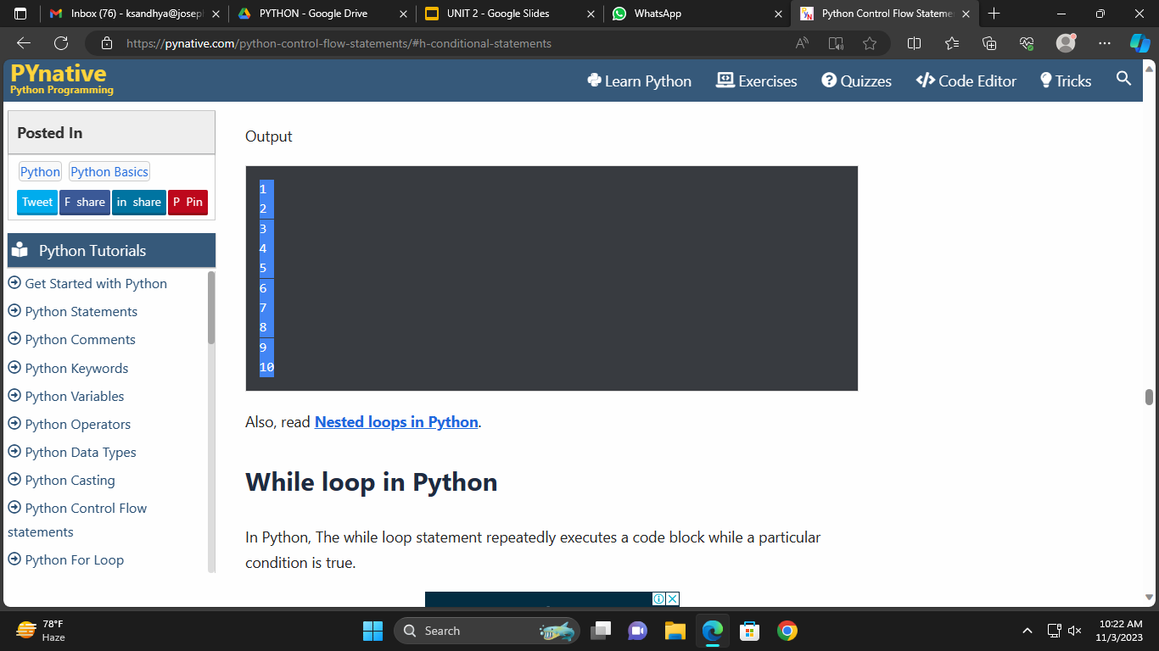
for loop
Syntax of for loop:
for element in sequence:
body of for loop
Program
for i in range(1, 11):
print(i)

Slide 48
Break Statement
The break statement is used inside the loop to exit out of the loop. It is useful when we want to terminate the loop as soon as the condition is fulfilled instead of doing the remaining iterations. It reduces execution time. Whenever the controller encountered a break statement, it comes out of that loop immediately
Program
for i in range(9):
if i == 3:
break
print(i)
Output
0
1
2

Slide 49
Continue statement
The continue statement is used to skip the current iteration and continue with the next iteration.
Program
for num in range(3, 8):
if num == 5:
continue
else:
print(num)
Output
3
4
6
7

Slide 50
Pass statement
The pass is the keyword In Python, which won’t do anything. Sometimes there is a situation in programming where we need to define a syntactically empty block. A pass statement is a Python null statement. When the interpreter finds a pass statement in the program, it returns no operation. Nothing happens when the pass statement is executed.
Example
months = ['January', 'June', 'March', 'April']
for mon in months:
pass
print(months)
Output
['January', 'June', 'March', 'April']

Slide 51
Set : Sets are used to store multiple items in a single variable.
Note: Set items are unchangeable, but you can remove items and add new items.
Sets are written with curly brackets.
thisset = {"apple", "banana", "cherry"}
print(thisset)
# Note: the set list is unordered, meaning: the items will appear in a random order.
# Refresh this page to see the change in the result.
Output
{'banana', 'apple', 'cherry'}

Slide 52
Duplicates Not Allowed
Sets cannot have two items with the same value.
thisset = {"apple", "banana", "cherry", "apple"}
print(thisset)
Output
{'banana', 'cherry', 'apple'}

Slide 53
Get the Length of a Set
To determine how many items a set has, use the len() function.
thisset = {"apple", "banana", "cherry"}
print(len(thisset))
Output
3

Slide 54
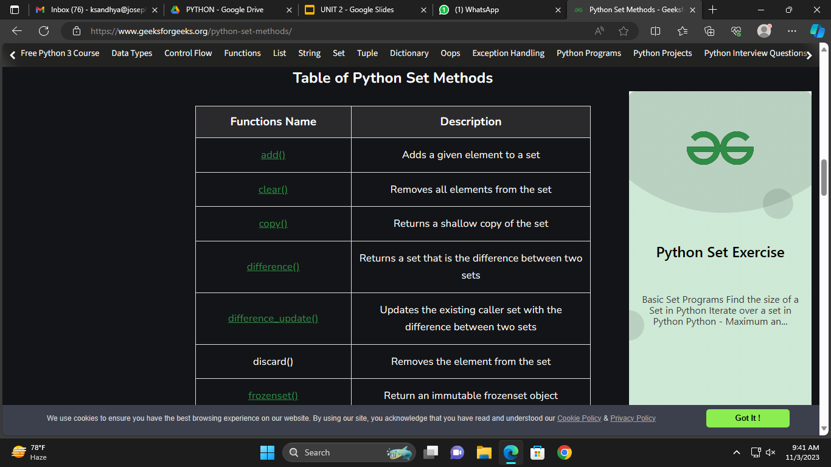
Set Methods

Slide 55
Set Methods
add() Method
thisset = {"apple", "banana", "cherry"}
thisset.add("orange")
print(thisset)
Output;
{'banana', 'cherry', 'orange', 'apple'}

Slide 56
Set Methods
add() Method : The add() method adds an element to the set.
If the element already exists, the add() method does not add the element.
Syntax
set.add(elmnt)
thisset = {"apple", "banana", "cherry"}
thisset.add("orange")
print(thisset)
Output;
{'banana', 'cherry', 'orange', 'apple'}

Slide 57
clear() Method : The clear() method removes all elements in a set.
Syntax
set.clear()
thisset = {"apple", "banana", "cherry"}
thisset.clear()
print(thisset)
Output:
set()

Slide 58
copy() Method : The copy() method copies the set.
Syntax
set.copy()
fruits = {"apple", "banana", "cherry"}
x = fruits.copy()
print(x)
Output:
{'apple', 'cherry', 'banana'}

Slide 59
remove() Method : The remove() method removes the specified element from the set. This method is different from the discard() method, because the remove() method will raise an error if the specified item does not exist, and the discard() method will not.
Syntax
set.remove(item)
fruits = {"apple", "banana", "cherry"}
fruits.remove("banana")
print(fruits)
Output:
{'apple', 'cherry'}

Slide 60
Comprehensions
● In Python, comprehensions are a concise way of creating new lists, dictionaries, sets, or other objects from existing iterable objects.
● They allow us to write simple and readable code for generating sequences, filtering, and transforming data.
There are two types of comprehensions in Python:
● list comprehensions
● dictionary/set comprehensions.
list comprehensions
A list comprehension is a compact way of creating a new list by applying an expression to each element of an existing list or any other iterable object and collecting the results.

Slide 61
The general syntax for a list comprehension is:
[expression for item in iterable if condition]
Example
numbers = [1, 2, 3, 4, 5]
squared = [n**2 for n in numbers]
print(squared) # [1, 4, 9, 16, 25]

Slide 62
Dictionary Comprehension
● we use dictionary comprehension to create a new dictionary from the list.
● Using comprehension in a dictionary, we can shrink the code and improve its readability and make it compact.
The basic syntax of dictionary comprehension is:
output_dictionary = {key:value for (key, value) in list if (condition)}
we have two lists named keys and value and we are iterating over them with the help of zip() function.

Slide 63
# Lists to represent keys and values
keys = ['a','b','c','d','e']
values = [1,2,3,4,5]
# but this line shows dict comprehension here
myDict = { k:v for (k,v) in zip(keys, values)}
# We can use below too
# myDict = dict(zip(keys, values))
print (myDict)
Output :
{'a': 1, 'b': 2, 'c': 3, 'd': 4, 'e': 5}

Slide 64
The zip() function in Python is used to combine two or more iterable dictionaries into a single iterable, where corresponding elements from the input iterable are paired together as tuples. When using zip() with dictionaries, it pairs the keys and values of the dictionaries based on their position in the dictionary.

Slide 65
Output :
{'a': 1, 'b': 2, 'c': 3, 'd': 4, 'e': 5}
myDict = {x: x**2 for x in [1,2,3,4,5]}
print (myDict)
Output :
{1: 1, 2: 4, 3: 9, 4: 16, 5: 25}

